Slide 1

COMPUTER ORGANIZATION AND ARCHITECTURE
Dept. of CSE, GIT
Visakhapatnam

Slide 2
UNIT V
Memory Organization
Memory Hierarchy, Main Memory
Auxiliary Memory
Associative Memories, Cache Memory
Virtual Memories
Memory Management Hardware

Slide 3
Memory Organization in Computer Architecture
A memory unit is the collection of storage units or devices together. The memory unit stores the binary information in the form of bits. Generally, memory/storage is classified into 2 categories:
Volatile Memory: This loses its data, when power is switched off.
Non-Volatile Memory: This is a permanent storage and does not lose any data when power is switched off.

Slide 4
Memory Organization in Computer Architecture
In the Computer System Design, Memory Hierarchy is an enhancement to organize the memory such that it can minimize the access time.
The Memory Hierarchy was developed based on a program behaviour known as locality of reference.
The figure below clearly demonstrates the different levels of memory hierarchy :

Slide 5
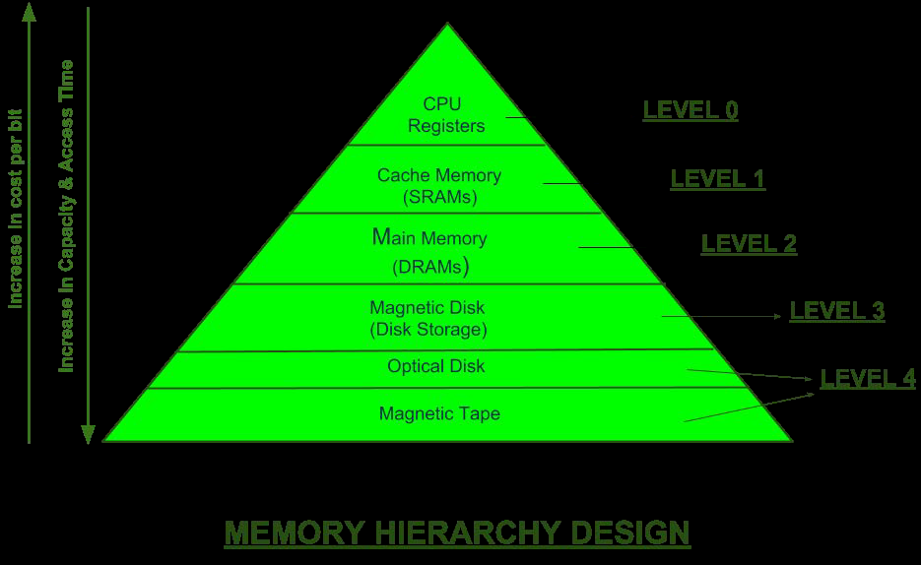

Memory Hierarchy

Slide 6
Memory Hierarchy
This Memory Hierarchy Design is divided into 2 main types:
1. External Memory or Secondary Memory –Comprising of Magnetic Disk, Optical Disk, Magnetic Tape i.e. peripheral storage devices which are accessible by the processor via I/O Module.
2. Internal Memory or Primary Memory –Comprising of Main Memory, Cache Memory & CPU registers. This is directly accessible by the processor.

Slide 7
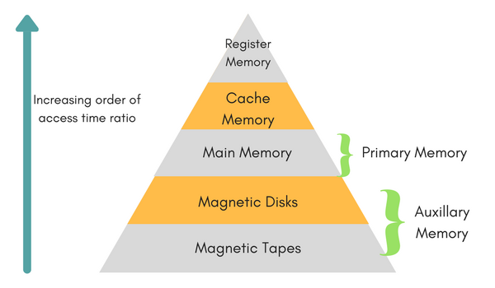
Memory Hierarchy

Slide 8
Memory Hierarchy
The memory hierarchy system consists of all storage devices contained in a computer system from the slow Auxiliary Memory to fast Main Memory and to smaller Cache memory.
Auxiliary memory access time is generally 1000 times that of the main memory, hence it is at the bottom of the hierarchy.
The main memory occupies the central position because it is equipped to communicate directly with the CPU and with auxiliary memory devices through Input/output processor (I/O).

Slide 9
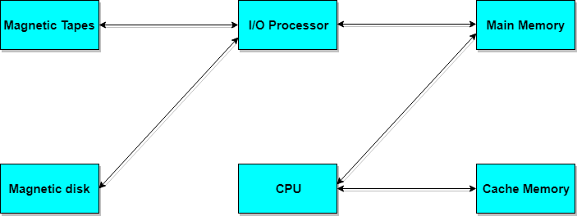
Memory Hierarchy in computer system

Slide 10
Memory Hierarchy in computer system
When the program not residing in main memory is needed by the CPU, they are brought in from auxiliary memory.
Programs not currently needed in main memory are transferred into auxiliary memory to provide space in main memory for other programs that are currently in use.
The cache memory is used to store the active part of the program which is currently being executed in the CPU.
Approximate access time ratio between cache memory and main memory is about 1 to 7~10

Slide 11

characteristics of Memory Hierarchy Design
1. Capacity: It is the global volume of information the memory can store. As we move from top to bottom in the Hierarchy, the capacity increases.
2. access Time:
It is the time interval between the read/write request and the availability of the data. As we move from top to bottom in the Hierarchy, the access time increases.

Slide 12
characteristics of Memory Hierarchy Design
3. Performance: Earlier when the computer system was designed without Memory Hierarchy design, the speed gap increases between the CPU registers and Main Memory due to large difference in access time. This results in lower performance of the system and thus, enhancement was required.
This enhancement was made in the form of Memory Hierarchy Design because of which the performance of the system increases. One of the most significant ways to increase system performance is minimizing how far down the memory hierarchy one has to go to manipulate data.
4. Cost per bit:
As we move from bottom to top in the Hierarchy, the cost per bit increases i.e. Internal Memory is costlier than External Memory.

Slide 13
Memory access Methods
Each memory type, is a collection of numerous memory locations.
To access data from any memory, first it must be located and then the data is read from the memory location.
Following are the methods to access information from memory locations:

Slide 14
Memory access Methods
Random access: Main memories are random access memories, in which each memory location has a unique address.
Using this unique address any memory location can be reached in the same amount of time in any order.
Sequential access: This methods allows memory access in a sequence or in order.
Direct access: In this mode, information is stored in tracks, with each track having a separate read/write head.

Slide 15
Main Memory
The memory unit that communicates directly within the CPU, Auxiliary memory and Cache memory, is called main memory.
It is the central storage unit of the computer system.
It is a large and fast memory used to store data during computer operations.
Main memory is made up of RAM and ROM, with RAM integrated circuit chips holing the major share.

Slide 16
RAM: Random access Memory
RAM, is a form of data storage that can be accessed randomly at any time, in any order and from any physical location in contrast to other storage devices, such as hard drives, where the physical location of the data determines the time taken to retrieve it.
RAM is measured in megabytes and the speed is measured in nanoseconds and RAM chips can read data faster than ROM.

Slide 17
Types of RAM
The two widely used forms of modern RAM are static RAM (SRAM) and dynamic RAM (DRAM).
In SRAM, a bit of data is stored using the state of a six transistor memory cell.
This form of RAM is more expensive to produce, but is generally faster and requires less dynamic power than DRAM.
In modern computers, SRAM is often used as cache memory for the CPU.

Slide 18
dram
DRAM stores a bit of data using a transistor and capacitor pair, which together comprise a DRAM cell.
The capacitor holds a high or low charge (1 or 0, respectively), and the transistor acts as a switch that lets the control circuitry on the chip read the capacitor's state of charge or change it.
As this form of memory is less expensive to produce than static RAM, it is the predominant form of computer memory used in modern computers. The figure below shows DRAM & SRAM.

Slide 19
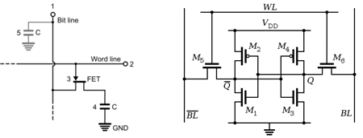
Both static and dynamic RAM are considered volatile, as their state is lost or reset when power is removed from the system.
DRAM: Dynamic RAM, is made of capacitors and transistors, and must be refreshed every 10~100 ms. It is slower and cheaper than SRAM.
SRAM: Static RAM, has a six transistor circuit in each cell and retains data, until powered off.
NVRAM: Non-Volatile RAM, retains its data, even when turned off. Example: Flash memory.

Slide 20
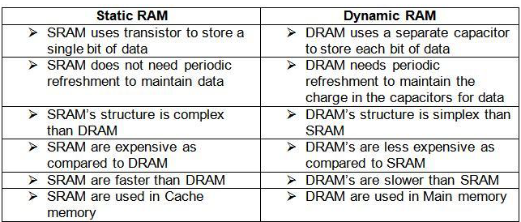

Difference between Static Ram And Dynamic Ram

Slide 21
ROM: Read Only Memory
ROM: Read Only Memory, is non-volatile and is more like a permanent storage for information.
It also stores the bootstrap loader program, to load and start the operating system when computer is turned on.
PROM(Programmable ROM), EPROM(Erasable PROM) and EEPROM(Electrically Erasable PROM) are some commonly used ROMs.

Slide 22
ROM
Read-only memory, or ROM, is a form of data storage in computers and other electronic device that cannot be easily altered or reprogrammed.
RAM is referred to as volatile memory and is lost when the power is turned off whereas ROM in non-volatile and the contents are retained even after the power is switched off.
Types of ROM: Semiconductor-Based
Classic mask-programmed ROM chips are integrated circuits that physically encode the data to be stored, and thus it is impossible to change their contents after fabrication.

Slide 23
pROM
Other types of non-volatile solid-state memory permit some degree of modification:
• Programmable read-only memory (PROM), or one-time programmable ROM (OTP), can be written to or programmed via a special device called a PROM programmer.
Typically, this device uses high voltages to permanently destroy or create internal links (fuses or antifuses) within the chip.
Consequently, a PROM can only be programmed once.

Slide 24
EPROM
Erasable programmable read-only memory (EPROM) can be erased by exposure to strong ultraviolet light (typically for 10 minutes or longer), then rewritten with a process that again needs higher than usual voltage applied.
Repeated exposure to UV light will eventually wear out an EPROM, but the endurance of most EPROM chips exceeds 1000 cycles of erasing and reprogramming.
EPROM chip packages can often be identified by the prominent quartz "window" which allows UV light to enter. After programming, the window is typically covered with a label to prevent accidental erasure.
Some EPROM chips are factory-erased before they are packaged, and include no window; these are effectively PROM.

Slide 25
EEPROM
Electrically erasable programmable read-only memory (EEPROM) is based on a similar semiconductor structure to EPROM, but allows its entire contents (or selected banks) to be electrically erased, then rewritten electrically, so that they need not be removed from the computer (whether general-purpose or an embedded computer in a camera, MP3 player, etc.).
Writing or flashing an EEPROM is much slower (milliseconds per bit) than reading from a ROM or writing to a RAM (nanoseconds in both cases).

Slide 26
EEPROM
Electrically alterable read-only memory (EAROM) is a type of EEPROM that can be modified one bit at a time.
Writing is a very slow process and again needs higher voltage (usually around 12 V) than is used for read access.
EAROMs are intended for applications that require infrequent and only partial rewriting.
EAROM may be used as non-volatile storage for critical system setup information; in many applications, EAROM has been supplanted by CMOS RAM supplied by mains power and backed-up with a lithium battery.

Slide 27
FLASH MEMORY
Flash memory (or simply flash) is a modern type of EEPROM invented in 1984. Flash memory can be erased and rewritten faster than ordinary EEPROM, and newer designs feature very high endurance (exceeding 1,000,000 cycles).
Modern NAND flash makes efficient use of silicon chip area, resulting in individual ICs with a capacity as high as 32 GB as of 2007; this feature, along with its endurance and physical durability, has allowed NAND flash to replace magnetic in some applications (such as USB flash drives).
Flash memory is sometimes called flash ROM or flash EEPROM when used as a replacement for older ROM types, but not in applications that take advantage of its ability to be modified quickly and frequently.

Slide 28
THANK YOU

Slide 29
Memory Organization
Memory hierarchy in a computer system:
Main Memory : memory unit that communicates directly with the CPU (RAM)
Auxiliary Memory : device that provide backup storage (Disk Drives)
Cache Memory : special very-high-speed memory to increase the processing speed (Cache RAM)
Multiprogramming: enable the CPU to process a number of independent program concurrently
Memory Management System: supervise the flow of information between auxiliary memory and main memory

Slide 30
Main Memory
The main memory is the central storage unit in a computer system. It is a relatively large and fast memory used to store programs and data.
The main memory are memory available in two possible operating modes, static and dynamic.
The static RAM consists essentially of internal flip-flops that store the binary information. The stored information remains valid as long as power is applied to the unit.
The dynamic RAM stores the binary information in the form of electric charges that are applied to capacitors. The capacitors are provided inside the chip by MOS transistors.

Slide 31
Main Memory
The dynamic RAM stores the binary information in the form of electric charges that are applied to capacitors. The capacitors are provided inside the chip by MOS transistors.
The stored charge on the capacitors tend to discharge with time and the capacitors must be periodically recharged by refreshing the dynamic memory.
Refreshing is done by cycling through the words every few milliseconds to restore the decaying charge.
The dynamic RAM offers reduced power consumption and larger storage capacity in a single memory chip.
The static RAM is easier to use and has shorter read and write Cycles.

Slide 32
Main Memory
RAM was used to refer to a random-access memory, but now it is used to designate a read/write memory to distinguish it from a read-only memory, although ROM is also random access.
RAM is used for storing the bulk of the programs and data that are subject to change.
ROM is used for storing programs that are permanently resident in the computer and for tables of constants that do not change in value once the production of the computer is completed.

Slide 33
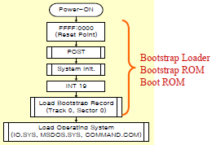
Main Memory
The ROM portion of main memory is needed for bootstrap loader storing an initial program called a bootstrap loader.
The bootstrap loader is a program whose function is to start the computer software operating when power is turned on. Since RAM is volatile, its contents are destroyed when power is turned off. The contents of ROM remain unchanged after power is turned off and on again.
The startup of a computer consists of turning the power on and starting the execution of an initial program.
Thus when power is turned on, the hardware of the computer sets the program counter to the first address of the bootstrap loader.
The bootstrap program loads a portion of the operating system from disk to main memory and control is then transferred to the operating system, which prepares the computer for general use.

Slide 34
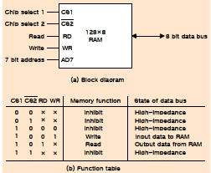
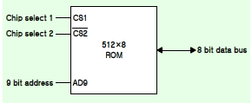

RAM and ROM chips Memory address map
Typical RAM chip : 128 X 8 RAM : 27 = 128 (7 bit address lines)
Typical ROM chip : 512 X 8 ROM : 29 = 512 (9 bit address lines)

Slide 35
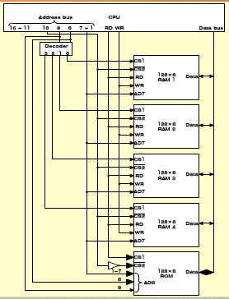
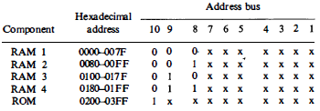
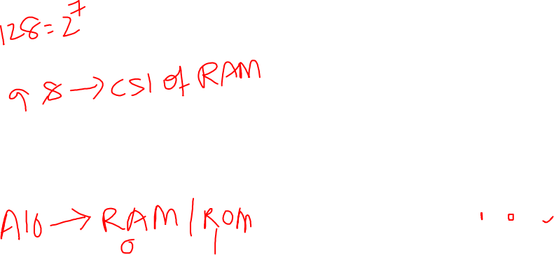
RAM and ROM chips Memory address map
Memory Configuration :
512 bytes RAM + 512 bytes ROM
1 x 512 byte ROM + 4 x 128 bytes RAM
Memory Connection to CPU :
2 x 4 Decoder : RAM select (CS1)
Address line 10
RAM select : CS2
ROM select : CS2 Invert
RD : ROM CS1

Slide 36
Auxiliary Memory
The most common auxiliary memory devices used in computer systems are magnetic disks and tapes. Other components used, but not as frequently, are magnetic drums, magnetic bubble memory, and optical disks.
The important characteristics of any device are its access mode, access time, transfer rate, capacity, and cost.
The average time required to reach a storage location in memory and obtain its contents is called the access time.
In electromechanical devices with moving parts such as disks and tapes, the access time consists of a seek time required to position the read-write head to a location and a transfer time required to transfer data to or from the device.
Because the seek time is usually much longer than the transfer time, auxiliary storage is organized in records or blocks.
The transfer rate is the number of characters or words that the device can transfer per second, after it has been positioned at the beginning of the record.
Notes:
The most common auxiliary memory devices used in computer systems are magnetic
disks and tapes. Other components used, but not as frequently, are magnetic drums, magnetic
bubble memory, and optical disks. The important characteristics of any device are its access
mode, access time, transfer rate, capacity, and cost. The average time required to reach a
storage location in memory and obtain its contents is called the access time. In
electromechanical devices with moving parts such as disks and tapes, the access time consists
of a seek time required to position the read-write head to a location and a transfer time
required to transfer data to or from the device. Because the seek time is usually much longer
than the transfer time, auxiliary storage is organized in records or blocks. A record is a
specified number of characters or words. Reading or writing is always done on entire records.
The transfer rate is the number of characters or words that the device can transfer per second,
after it has been positioned at the beginning of the record.

Slide 37
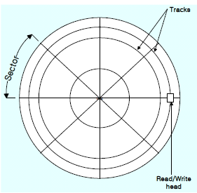
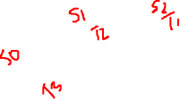
Magnetic Disks
A magnetic disk is a circular plate constructed of metal or plastic coated with magnetized material.
Often both sides of the disk are used and several disks may be stacked on one spindle with read/write heads available on each surface.
All disks rotate together at high speed and are not stopped or started for access purposes.
Bits are stored in the magnetized surface in spots along concentric circles called tracks. The tracks are commonly divided into sections called sectors.
In most systems, the minimum quantity of information which can be transferred is a sector

Slide 38
Magnetic Disks
Some units use a single read/write head for each disk surface. In this type of unit, the track address bits are used by a mechanical assembly to move the head into the specified track position before reading or writing.
In other disk systems, separate read/write heads are provided for each track in each surface.
The address bits can then select a particular track electronically through a decoder circuit. This type of unit is more expensive and is found only in very large computer systems.

Slide 39
Magnetic Disks
Permanent timing tracks are used in disks to synchronize the bits and recognize the sectors.
A disk system is addressed by address bits that specify the disk number, the disk surface, the sector number and the track within the sector.
After the read/write heads are positioned in the specified track, the system has to wait until the rotating disk reaches the specified sector under the read/write head.
Information transfer is very fast once the beginning of a sector has been reached.
Disks may have multiple heads and simultaneous transfer of bits from several tracks at the same time.

Slide 40
Magnetic Disks
A track in a given sector near the circumference is longer than a track near the center of the disk.
If bits are recorded with equal density, some tracks will contain more recorded bits than others.
To make all the records in a sector of equal length, some disks use a variable recording density with higher density on tracks near the center than on tracks near the circumference. This equalizes the number of bits on all tracks of a given sector.

Slide 41
Magnetic Disks
Disks that are permanently attached to the unit assembly and cannot be removed by the occasional user are called hard disks.
A disk drive with removable disks is called a floppy disk.
The disks used with a floppy disk drive are small removable disks made of plastic coated with magnetic recording material. There are two sizes commonly used, with diameters of 5.25 and 3.5 inches.
The 3.5-inch disks are smaller and can store more data than can the 5.25-inch disks. Floppy disks are extensively used in personal computers as a medium for distributing software to computer users.

Slide 42
MAGNETIC TAPE
A magnetic tape transport consists of the electrical, mechanical, and electronic components to provide the parts and control mechanism for a magnetic-tape unit.
The tape itself is a strip of plastic coated with a magnetic recording medium. Bits are recorded as magnetic spots on the tape along several tracks.
Usually, seven or nine bits are recorded simultaneously to form a character together with a parity bit.
Read/write heads are mounted one in each track so that data can be recorded and-read as a sequence of characters.
Magnetic tape units can be stopped, started to move forward or in reverse, or can be rewound.
However, they cannot be started or stopped fast enough between individual characters.

Slide 43
MAGNETIC TAPE
For this reason, information is recorded in blocks referred to as records. Gaps of unrecorded tape are inserted between records where the tape can be stopped.
The tape starts moving while in a gap and attains its constant speed by the time it reaches the next record.
Each record on tape has an identification bit pattern at the beginning and end.
By reading the bit pattern at the beginning, the tape control identifies the record number.
By reading the bit pattern at the end of the record, the control recognizes the beginning of a gap.
A tape unit is addressed by specifying the record number and the number of characters in the record. Records may be of fixed or variable length.

Slide 44

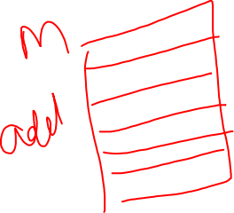
Associative Memory
A memory unit accessed by content is called an associative memory or content addressable memory (CAM).
This type of memory is accessed simultaneously and in parallel on the basis of data content rather than by specific address or location.
When a word is written in an associative memory, no address is given.
The memory is capable of finding an empty unused location to store the word.

Slide 45
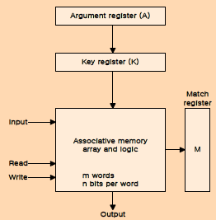


Hardware Organization of Associative Memory
It consists of a memory array and logic for m words with n bits per word.
The argument register A and key register K each have n bits, one for each bit of a word.
The match register M has m bits, one for each memory word.
Each word in memory is compared in parallel with the content of the argument register.
The words that match the bits of the argument register set a corresponding bit in the match register.
Notes:
It consists of a memory
array and logic for m words with n bits per word. The argument register A and key register K
each have n bits, one for each bit of a word. The match register M has m bits, one for each
memory word. Each word in memory is compared in parallel with the content of the
argument register. The words that match the bits of the argument register set a corresponding
bit in the match register. After the matching process, those bits in the match register that
have been set indicate the fact that their corresponding words have been matched. Reading is
accomplished by a sequential access to memory for those words whose corresponding bits in
the match register have been set.
The key register provides a mask for choosing a particular field or key in theargument word.
The entire argument is compared with each memory word if the key register contains all l's.
Thus the key provides a mask or identifying piece of information which specifies how the
reference to memory is made.

Slide 46
Hardware Organization of Associative Memory
After the matching process, those bits in the match register that have been set indicate the fact that their corresponding words have been matched.
Reading is accomplished by a sequential access to memory for those words whose corresponding bits in the match register have been set.
Notes:
It consists of a memory
array and logic for m words with n bits per word. The argument register A and key register K
each have n bits, one for each bit of a word. The match register M has m bits, one for each
memory word. Each word in memory is compared in parallel with the content of the
argument register. The words that match the bits of the argument register set a corresponding
bit in the match register. After the matching process, those bits in the match register that
have been set indicate the fact that their corresponding words have been matched. Reading is
accomplished by a sequential access to memory for those words whose corresponding bits in
the match register have been set.
The key register provides a mask for choosing a particular field or key in theargument word.
The entire argument is compared with each memory word if the key register contains all l's.
Thus the key provides a mask or identifying piece of information which specifies how the
reference to memory is made.

Slide 47
Hardware Organization of Associative Memory
The key register provides a mask for choosing a particular field or key in the argument word.
The entire argument is compared with each memory word if the key register contains all 1's.
Thus the key provides a mask or identifying piece of information which specifies how the reference to memory is made.
Notes:
It consists of a memory
array and logic for m words with n bits per word. The argument register A and key register K
each have n bits, one for each bit of a word. The match register M has m bits, one for each
memory word. Each word in memory is compared in parallel with the content of the
argument register. The words that match the bits of the argument register set a corresponding
bit in the match register. After the matching process, those bits in the match register that
have been set indicate the fact that their corresponding words have been matched. Reading is
accomplished by a sequential access to memory for those words whose corresponding bits in
the match register have been set.
The key register provides a mask for choosing a particular field or key in theargument word.
The entire argument is compared with each memory word if the key register contains all l's.
Thus the key provides a mask or identifying piece of information which specifies how the
reference to memory is made.

Slide 48
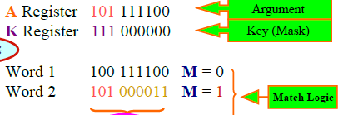

Hardware Organization of Associative Memory
Numerical example: Only the three leftmost bits of A are compared with memory words because K has 1's in these positions.
Word 2 matches the unmasked argument field because the three leftmost bits of the argument and the word are equal.
Notes:
It consists of a memory
array and logic for m words with n bits per word. The argument register A and key register K
each have n bits, one for each bit of a word. The match register M has m bits, one for each
memory word. Each word in memory is compared in parallel with the content of the
argument register. The words that match the bits of the argument register set a corresponding
bit in the match register. After the matching process, those bits in the match register that
have been set indicate the fact that their corresponding words have been matched. Reading is
accomplished by a sequential access to memory for those words whose corresponding bits in
the match register have been set.
The key register provides a mask for choosing a particular field or key in theargument word.
The entire argument is compared with each memory word if the key register contains all l's.
Thus the key provides a mask or identifying piece of information which specifies how the
reference to memory is made.

Slide 49
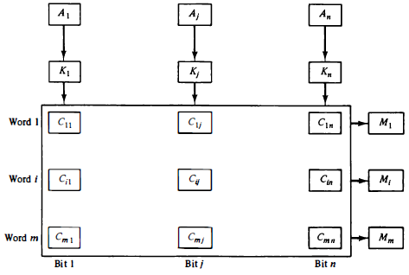

Hardware Organization of Associative Memory
The relation between the memory array and external registers in an associative memory is shown in Fig.
The cells in the array are marked by the letter C with two subscripts.
The first subscript gives the word number and the second specifies the bit position in the word.
Thus cell Cij is the cell for bit j in word i.
Notes:
It consists of a memory
array and logic for m words with n bits per word. The argument register A and key register K
each have n bits, one for each bit of a word. The match register M has m bits, one for each
memory word. Each word in memory is compared in parallel with the content of the
argument register. The words that match the bits of the argument register set a corresponding
bit in the match register. After the matching process, those bits in the match register that
have been set indicate the fact that their corresponding words have been matched. Reading is
accomplished by a sequential access to memory for those words whose corresponding bits in
the match register have been set.
The key register provides a mask for choosing a particular field or key in theargument word.
The entire argument is compared with each memory word if the key register contains all l's.
Thus the key provides a mask or identifying piece of information which specifies how the
reference to memory is made.

Slide 50

Hardware Organization of Associative Memory
A bit Aj in the argument register is compared with all the bits in column j of the array provided that Kj = 1. This is done for all columns j = 1, 2, . . . , n.
If a match occurs between all the unmasked bits of the argument and the bits in word i, the corresponding bit in the match register is set to 1.
If one or more unmasked bits of the argument and the word do not match, Mi is cleared to 0.
Notes:
It consists of a memory
array and logic for m words with n bits per word. The argument register A and key register K
each have n bits, one for each bit of a word. The match register M has m bits, one for each
memory word. Each word in memory is compared in parallel with the content of the
argument register. The words that match the bits of the argument register set a corresponding
bit in the match register. After the matching process, those bits in the match register that
have been set indicate the fact that their corresponding words have been matched. Reading is
accomplished by a sequential access to memory for those words whose corresponding bits in
the match register have been set.
The key register provides a mask for choosing a particular field or key in theargument word.
The entire argument is compared with each memory word if the key register contains all l's.
Thus the key provides a mask or identifying piece of information which specifies how the
reference to memory is made.

Slide 51
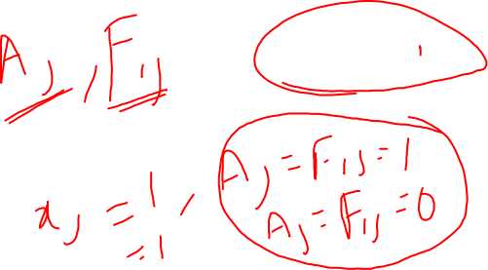
Associative Memory- Match Logic
The match logic for each word can be derived from the comparison algorithm for two binary numbers.
First, we neglect the key bits and compare the argument in A with the bits stored in the cells of the words.
Word i is equal to the argument in A if Aj=Fij for j = 1, 2, . . . , n .
Two bits are equal if they are both 1 or both 0. The equality of two bits can be expressed logically by the Boolean function
Where xj = 1 if the pair of bits in position j are equal; otherwise, xj = 0.
Notes:
It consists of a memory
array and logic for m words with n bits per word. The argument register A and key register K
each have n bits, one for each bit of a word. The match register M has m bits, one for each
memory word. Each word in memory is compared in parallel with the content of the
argument register. The words that match the bits of the argument register set a corresponding
bit in the match register. After the matching process, those bits in the match register that
have been set indicate the fact that their corresponding words have been matched. Reading is
accomplished by a sequential access to memory for those words whose corresponding bits in
the match register have been set.
The key register provides a mask for choosing a particular field or key in theargument word.
The entire argument is compared with each memory word if the key register contains all l's.
Thus the key provides a mask or identifying piece of information which specifies how the
reference to memory is made.

Slide 52
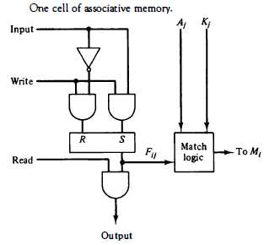
Associative Memory- Match Logic
For a word i to be equal to the argument in A we must have all xj variables equal to 1.
This is the condition for setting the corresponding match bit Mi to 1.
The Boolean function for this condition is Mi = 𝑥1 𝑥2 𝑥3 … … … 𝑥𝑛 and constitutes the AND operation of all pairs of matched bits in a word.
Notes:
It consists of a memory
array and logic for m words with n bits per word. The argument register A and key register K
each have n bits, one for each bit of a word. The match register M has m bits, one for each
memory word. Each word in memory is compared in parallel with the content of the
argument register. The words that match the bits of the argument register set a corresponding
bit in the match register. After the matching process, those bits in the match register that
have been set indicate the fact that their corresponding words have been matched. Reading is
accomplished by a sequential access to memory for those words whose corresponding bits in
the match register have been set.
The key register provides a mask for choosing a particular field or key in theargument word.
The entire argument is compared with each memory word if the key register contains all l's.
Thus the key provides a mask or identifying piece of information which specifies how the
reference to memory is made.

Slide 53

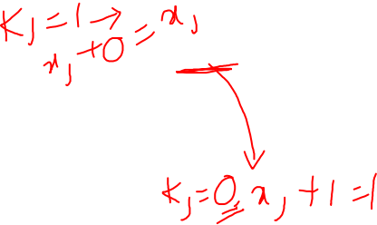
Associative Memory- Match Logic
We now include the key bit K; in the comparison logic.
The requirement is that if Kj = 0, the corresponding bits of A; and Fij need no comparison.
Only when Kj = 1 must they be compared.
This requirement is achieved by Oring each term with Kj’, thus:
When Kj = 1, we have Kj’ = 0 and xj+0 = xj. When Kj = 0, then Kj’ = 1 and xj+ 1 = 1.
A term (xj + Kj’) will be in the 1 state if its pair of bits is not compared.
This is necessary because each term is ANDed with all other terms so that an output of 1 will have no effect. The comparison of the bits has an effect only when Kj = 1 .
Notes:
It consists of a memory
array and logic for m words with n bits per word. The argument register A and key register K
each have n bits, one for each bit of a word. The match register M has m bits, one for each
memory word. Each word in memory is compared in parallel with the content of the
argument register. The words that match the bits of the argument register set a corresponding
bit in the match register. After the matching process, those bits in the match register that
have been set indicate the fact that their corresponding words have been matched. Reading is
accomplished by a sequential access to memory for those words whose corresponding bits in
the match register have been set.
The key register provides a mask for choosing a particular field or key in theargument word.
The entire argument is compared with each memory word if the key register contains all l's.
Thus the key provides a mask or identifying piece of information which specifies how the
reference to memory is made.

Slide 54

Associative Memory- Match Logic
The match logic for word i in an associative memory can now be expressed by the following Boolean function:
Each term in the expression will be equal to 1 if its corresponding Kj = 0.
If Kj = 1, the term will be either 0 or 1 depending on the value of Xj.
A match will occur and Mj, will be equal to 1 if all terms are equal to 1.
If we substitute the original definition of xj, the Boolean function above can be expressed as follows:
where II is a product symbol designating the AND operation of all n terms. We need m such functions, one for each word i = 1, 2, 3, . . . , m .
Notes:
It consists of a memory
array and logic for m words with n bits per word. The argument register A and key register K
each have n bits, one for each bit of a word. The match register M has m bits, one for each
memory word. Each word in memory is compared in parallel with the content of the
argument register. The words that match the bits of the argument register set a corresponding
bit in the match register. After the matching process, those bits in the match register that
have been set indicate the fact that their corresponding words have been matched. Reading is
accomplished by a sequential access to memory for those words whose corresponding bits in
the match register have been set.
The key register provides a mask for choosing a particular field or key in theargument word.
The entire argument is compared with each memory word if the key register contains all l's.
Thus the key provides a mask or identifying piece of information which specifies how the
reference to memory is made.

Slide 55
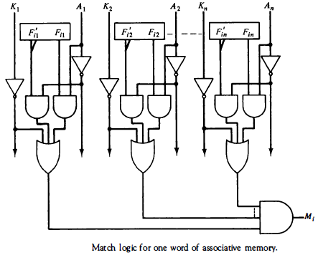
Associative Memory- Match Logic
Notes:
It consists of a memory
array and logic for m words with n bits per word. The argument register A and key register K
each have n bits, one for each bit of a word. The match register M has m bits, one for each
memory word. Each word in memory is compared in parallel with the content of the
argument register. The words that match the bits of the argument register set a corresponding
bit in the match register. After the matching process, those bits in the match register that
have been set indicate the fact that their corresponding words have been matched. Reading is
accomplished by a sequential access to memory for those words whose corresponding bits in
the match register have been set.
The key register provides a mask for choosing a particular field or key in theargument word.
The entire argument is compared with each memory word if the key register contains all l's.
Thus the key provides a mask or identifying piece of information which specifies how the
reference to memory is made.

Slide 56
Associative Memory- Read operation
If more than one word in memory matches the unmasked argument field, all the matched words will have 1's in the corresponding bit position of the match register.
It is then necessary to scan the bits of the match register one at a time.
The matched words are read in sequence by applying a read signal to each word line whose corresponding Mi, bit is a 1.
In most applications, the associative memory stores a table with no two identical items under a given key.
In this case, only one word may match the unmasked argument field.
By connecting output Mi directly to the read line in the same word position, the content of the matched word will be presented automatically at the output lines and no special read command signal is needed.
Notes:
It consists of a memory
array and logic for m words with n bits per word. The argument register A and key register K
each have n bits, one for each bit of a word. The match register M has m bits, one for each
memory word. Each word in memory is compared in parallel with the content of the
argument register. The words that match the bits of the argument register set a corresponding
bit in the match register. After the matching process, those bits in the match register that
have been set indicate the fact that their corresponding words have been matched. Reading is
accomplished by a sequential access to memory for those words whose corresponding bits in
the match register have been set.
The key register provides a mask for choosing a particular field or key in theargument word.
The entire argument is compared with each memory word if the key register contains all l's.
Thus the key provides a mask or identifying piece of information which specifies how the
reference to memory is made.

Slide 57
Associative Memory- Write operation
An associative memory must have a write capability for storing the information to be searched.
If the entire memory is loaded with new information at once prior to a search operation then the writing can be done by addressing each location in sequence instead of having m address lines, one for each word in memory, the number address lines can be reduced by the decoder to d lines, where m = 2^{𝑑} .
If unwanted words have to be deleted and new words inserted one at a time, there is a need for a special register to distinguish between active and inactive words. This register, sometimes called a tag register, would have as many bits as there are words in the memory. A word is deleted from memory by clearing its tag bit to 0. Words are stored in memory by scanning the tag register until the first 0 bit is encountered. The words that have a tag bit of 0 must be masked (together with the K, bits) with the argument word so that only active words are compared.
Notes:
It consists of a memory
array and logic for m words with n bits per word. The argument register A and key register K
each have n bits, one for each bit of a word. The match register M has m bits, one for each
memory word. Each word in memory is compared in parallel with the content of the
argument register. The words that match the bits of the argument register set a corresponding
bit in the match register. After the matching process, those bits in the match register that
have been set indicate the fact that their corresponding words have been matched. Reading is
accomplished by a sequential access to memory for those words whose corresponding bits in
the match register have been set.
The key register provides a mask for choosing a particular field or key in theargument word.
The entire argument is compared with each memory word if the key register contains all l's.
Thus the key provides a mask or identifying piece of information which specifies how the
reference to memory is made.

Slide 58
THANK YOU

Slide 59
Cache Memory
Analysis of a large number of typical programs has shown that the references memory at any given interval of time tend to be confined within a few localized areas in memory. This phenomenon is known as the property of locality of reference.
Ex: When a program loop is executed → CPU repeatedly refers to the set of instructions in memory
Every time a given subroutine is called, its set of instructions are fetched from memory.
To a lesser degree, memory references to data also tend to be localized. Tablelookup procedures repeatedly refer to that portion in memory where the table is stored.
Iterative procedures refer to common memory locations and array of numbers are confined within a local portion of memory. The result of all these observations is the locality of reference property, which states that over a short interval of time, the addresses generated by a typical program refer to a few localized areas of memory repeatedly, while the remainder of memory is accessed relatively infrequently.
Notes:
It consists of a memory
array and logic for m words with n bits per word. The argument register A and key register K
each have n bits, one for each bit of a word. The match register M has m bits, one for each
memory word. Each word in memory is compared in parallel with the content of the
argument register. The words that match the bits of the argument register set a corresponding
bit in the match register. After the matching process, those bits in the match register that
have been set indicate the fact that their corresponding words have been matched. Reading is
accomplished by a sequential access to memory for those words whose corresponding bits in
the match register have been set.
The key register provides a mask for choosing a particular field or key in theargument word.
The entire argument is compared with each memory word if the key register contains all l's.
Thus the key provides a mask or identifying piece of information which specifies how the
reference to memory is made.

Slide 60
Cache Memory
If the active portions of the program and data are placed in a fast small memory, the average memory access time can be reduced. Such a fast small memory is referred to as a cache memory.
The cache is the fastest component in the memory hierarchy and approaches the speed of CPU components.
The fundamental idea of cache organization is that by keeping the most frequently accessed instructions and data in the fast cache memory, the average memory access time will approach the access time of the cache.
Although the cache is only a small fraction of the size of main memory, a large fraction of memory requests will be found in the fast cache memory because of the locality of reference property of programs.
Notes:
It consists of a memory
array and logic for m words with n bits per word. The argument register A and key register K
each have n bits, one for each bit of a word. The match register M has m bits, one for each
memory word. Each word in memory is compared in parallel with the content of the
argument register. The words that match the bits of the argument register set a corresponding
bit in the match register. After the matching process, those bits in the match register that
have been set indicate the fact that their corresponding words have been matched. Reading is
accomplished by a sequential access to memory for those words whose corresponding bits in
the match register have been set.
The key register provides a mask for choosing a particular field or key in theargument word.
The entire argument is compared with each memory word if the key register contains all l's.
Thus the key provides a mask or identifying piece of information which specifies how the
reference to memory is made.

Slide 61
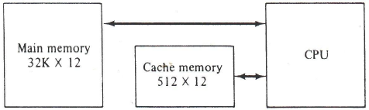
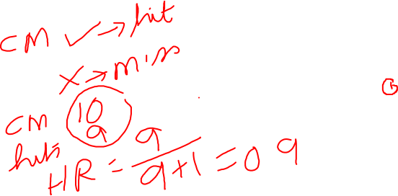
Cache Memory operation
When the CPU needs to access memory, the cache is examined.
If the word is found in the cache, it is read from the fast memory.
If the word addressed by the CPU is not found in the cache, the main memory is accessed to read the word.
A block of words containing the one just accessed is then transferred from main memory to cache memory.
The block size may vary from one word to about 16 words adjacent to the one just accessed.
Notes:
It consists of a memory
array and logic for m words with n bits per word. The argument register A and key register K
each have n bits, one for each bit of a word. The match register M has m bits, one for each
memory word. Each word in memory is compared in parallel with the content of the
argument register. The words that match the bits of the argument register set a corresponding
bit in the match register. After the matching process, those bits in the match register that
have been set indicate the fact that their corresponding words have been matched. Reading is
accomplished by a sequential access to memory for those words whose corresponding bits in
the match register have been set.
The key register provides a mask for choosing a particular field or key in theargument word.
The entire argument is compared with each memory word if the key register contains all l's.
Thus the key provides a mask or identifying piece of information which specifies how the
reference to memory is made.

Slide 62
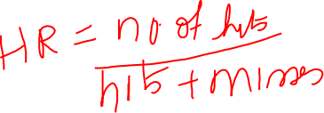
Cache Memory operation
The performance of cache memory is frequently measured in terms of a quantity called hit ratio.
When the CPU refers to memory and finds the word in cache, it is said to produce a hit.
If the word is not found in cache, it is in main memory and it counts as a, miss.
Ratio of the number of hits divided by the total CPU references to memory (hits plus misses) is the hit ratio.
Hit ratios of 0.9 and higher have been reported. This high ratio verifies the validity of the locality of reference property.
If the hit ratio is high enough so that most of the time the CPU accesses the cache instead of main memory, the average access time is closer to the access time of the fast cache memory.
Notes:
It consists of a memory
array and logic for m words with n bits per word. The argument register A and key register K
each have n bits, one for each bit of a word. The match register M has m bits, one for each
memory word. Each word in memory is compared in parallel with the content of the
argument register. The words that match the bits of the argument register set a corresponding
bit in the match register. After the matching process, those bits in the match register that
have been set indicate the fact that their corresponding words have been matched. Reading is
accomplished by a sequential access to memory for those words whose corresponding bits in
the match register have been set.
The key register provides a mask for choosing a particular field or key in theargument word.
The entire argument is compared with each memory word if the key register contains all l's.
Thus the key provides a mask or identifying piece of information which specifies how the
reference to memory is made.

Slide 63
Cache Memory- Mapping procedures
The transformation of data from main memory to cache memory is referred to as a mapping process.
Three types of mapping procedures are of practical interest when considering the organization of cache memory:
1. Associative mapping
2. Direct mapping
3. Set-associative mapping
Ex: a computer with cache access time of 100 ns, a main memory access time of 1000 ns, and a hit ratio of 0.9 produces an average access time of 200 ns. This is a considerable improvement over a similar computer without a cache memory, whose access time is 1000 ns
Notes:
It consists of a memory
array and logic for m words with n bits per word. The argument register A and key register K
each have n bits, one for each bit of a word. The match register M has m bits, one for each
memory word. Each word in memory is compared in parallel with the content of the
argument register. The words that match the bits of the argument register set a corresponding
bit in the match register. After the matching process, those bits in the match register that
have been set indicate the fact that their corresponding words have been matched. Reading is
accomplished by a sequential access to memory for those words whose corresponding bits in
the match register have been set.
The key register provides a mask for choosing a particular field or key in theargument word.
The entire argument is compared with each memory word if the key register contains all l's.
Thus the key provides a mask or identifying piece of information which specifies how the
reference to memory is made.

Slide 64
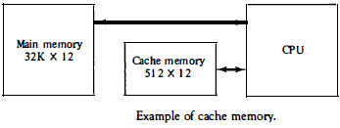
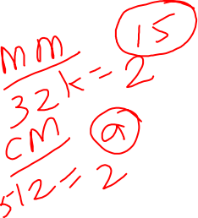
Cache Memory- Mapping procedures
The main memory can store 32K words of 12 bits each.
The cache is capable of storing 512 of these words at any given time. For every word stored in cache, there is a duplicate copy in main memory.
The CPU communicates with both memo­ries.
It first sends a 15-bit address to cache. If there is a hit, the CPU accepts the 12-bit data from cache.
If there is a miss, the CPU reads the word from main memory and the word is then transferred to cache.
Notes:
It consists of a memory
array and logic for m words with n bits per word. The argument register A and key register K
each have n bits, one for each bit of a word. The match register M has m bits, one for each
memory word. Each word in memory is compared in parallel with the content of the
argument register. The words that match the bits of the argument register set a corresponding
bit in the match register. After the matching process, those bits in the match register that
have been set indicate the fact that their corresponding words have been matched. Reading is
accomplished by a sequential access to memory for those words whose corresponding bits in
the match register have been set.
The key register provides a mask for choosing a particular field or key in theargument word.
The entire argument is compared with each memory word if the key register contains all l's.
Thus the key provides a mask or identifying piece of information which specifies how the
reference to memory is made.

Slide 65
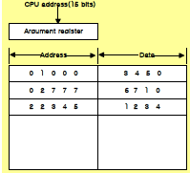

Associative Mapping
The associative memory stores both the address and content (data) of the memory word.
The address value of 15 bits is shown as a five-digit octal number and its corresponding 12-bit word is shown as a four-digit octal number.
A CPU address of 15 bits is placed in the argument register and the associative memory is searched for a matching address.
If the address is found, the corresponding 12-bit data is read and sent to the CPU. If no match occurs, the main memory is accessed for the word. The address data pair is then transferred to the associative cache memory.
Notes:
It consists of a memory
array and logic for m words with n bits per word. The argument register A and key register K
each have n bits, one for each bit of a word. The match register M has m bits, one for each
memory word. Each word in memory is compared in parallel with the content of the
argument register. The words that match the bits of the argument register set a corresponding
bit in the match register. After the matching process, those bits in the match register that
have been set indicate the fact that their corresponding words have been matched. Reading is
accomplished by a sequential access to memory for those words whose corresponding bits in
the match register have been set.
The key register provides a mask for choosing a particular field or key in theargument word.
The entire argument is compared with each memory word if the key register contains all l's.
Thus the key provides a mask or identifying piece of information which specifies how the
reference to memory is made.

Slide 66
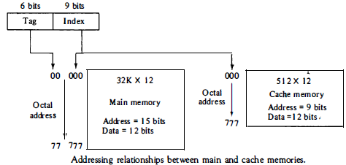

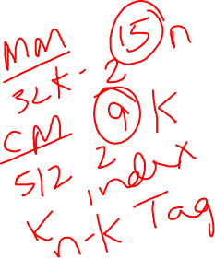
Direct Mapping
Associative memories are expensive compared to random-access memories because of the added logic associated with each cell.
The CPU address of 15 bits is divided into two fields. The nine least significant bits constitute the index field and the remaining six bits form the tag field.
In the general case, there are 2^k words in cache memory and 2^n words in main memory.
The n-bit memory address is divided into two fields: k bits for the index field and n-k bits for the tag field.
Notes:
It consists of a memory
array and logic for m words with n bits per word. The argument register A and key register K
each have n bits, one for each bit of a word. The match register M has m bits, one for each
memory word. Each word in memory is compared in parallel with the content of the
argument register. The words that match the bits of the argument register set a corresponding
bit in the match register. After the matching process, those bits in the match register that
have been set indicate the fact that their corresponding words have been matched. Reading is
accomplished by a sequential access to memory for those words whose corresponding bits in
the match register have been set.
The key register provides a mask for choosing a particular field or key in theargument word.
The entire argument is compared with each memory word if the key register contains all l's.
Thus the key provides a mask or identifying piece of information which specifies how the
reference to memory is made.

Slide 67
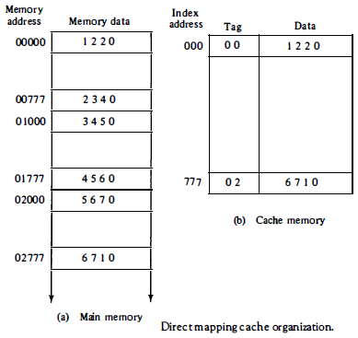


Direct Mapping
The direct mapping cache organization uses the n-bit address to access the main memory and the k-bit index to access the cache.
When the CPU generates a memory request, the index field is used for the address to access the cache. The tag field of the CPU address is compared with the tag in the word read from the cache.
If the two tags match, there is a hit and the desired data word is in cache.
If there is no match, there is a miss and the required word is read from main memory. It is then stored in the cache together with the new tag, replacing the previous value.
Notes:
It consists of a memory
array and logic for m words with n bits per word. The argument register A and key register K
each have n bits, one for each bit of a word. The match register M has m bits, one for each
memory word. Each word in memory is compared in parallel with the content of the
argument register. The words that match the bits of the argument register set a corresponding
bit in the match register. After the matching process, those bits in the match register that
have been set indicate the fact that their corresponding words have been matched. Reading is
accomplished by a sequential access to memory for those words whose corresponding bits in
the match register have been set.
The key register provides a mask for choosing a particular field or key in theargument word.
The entire argument is compared with each memory word if the key register contains all l's.
Thus the key provides a mask or identifying piece of information which specifies how the
reference to memory is made.

Slide 68

Direct Mapping
Ex: The word at address zero is presently stored in the cache (index = 000, tag = 00, data = 1220). Suppose that the CPU now wants to access the word at address 02000. The index address is 000, so it is used to access the cache. The two tags are then compared. The cache tag is 00 but the address tag is 02, which does not produce a match. Therefore, the main memory is accessed and the data word 5670 is transferred to the CPU. The cache word at index address 000 is then replaced with a tag of 02 and data of 5670.
Notes:
It consists of a memory
array and logic for m words with n bits per word. The argument register A and key register K
each have n bits, one for each bit of a word. The match register M has m bits, one for each
memory word. Each word in memory is compared in parallel with the content of the
argument register. The words that match the bits of the argument register set a corresponding
bit in the match register. After the matching process, those bits in the match register that
have been set indicate the fact that their corresponding words have been matched. Reading is
accomplished by a sequential access to memory for those words whose corresponding bits in
the match register have been set.
The key register provides a mask for choosing a particular field or key in theargument word.
The entire argument is compared with each memory word if the key register contains all l's.
Thus the key provides a mask or identifying piece of information which specifies how the
reference to memory is made.

Slide 69
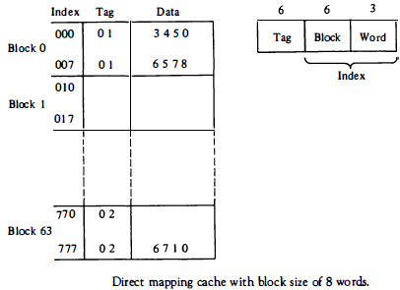
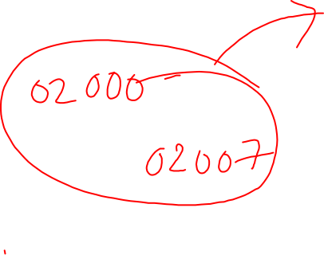
Direct Mapping cache with block size of 8 words
The index field is now divided into two parts: the block field and the word field.
In a 512-word cache there are 64 blocks of 8 words each, since 64 x 8 = 512.
The block number is specified with a 6-bit field and the word within the block is specified with a 3-bit field.
The tag field stored within the cache is common to all eight words of the same block.
Every time a miss occurs, an entire block of eight words must be transferred from main memory to cache memory.
Although this takes extra time, the hit ratio will most likely improve with a larger block size because of the sequential nature of computer programs.
Notes:
It consists of a memory
array and logic for m words with n bits per word. The argument register A and key register K
each have n bits, one for each bit of a word. The match register M has m bits, one for each
memory word. Each word in memory is compared in parallel with the content of the
argument register. The words that match the bits of the argument register set a corresponding
bit in the match register. After the matching process, those bits in the match register that
have been set indicate the fact that their corresponding words have been matched. Reading is
accomplished by a sequential access to memory for those words whose corresponding bits in
the match register have been set.
The key register provides a mask for choosing a particular field or key in theargument word.
The entire argument is compared with each memory word if the key register contains all l's.
Thus the key provides a mask or identifying piece of information which specifies how the
reference to memory is made.

Slide 70
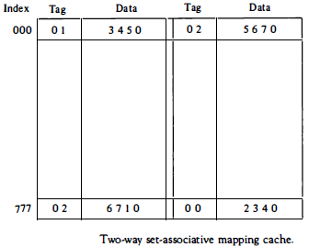

Set-associative mapping
The disadvantage of direct mapping is that two words with the same index in their address but with different tag values cannot reside in cache memory at the same time.
A third type of cache organization, called set-associative mapping, is an improvement over the direct-mapping organization in that each word of cache can store two or more words of memory under the same index address.
Each data word is stored together with its tag and the number of tag data items in one word of cache is said to form a set.
Each tag requires six bits and each data word has 12 bits, so the word length is (6 + 12) = 36 bits.
An index address of nine bits can accommodate 512 words.
Thus the size of cache memory is 512x 36.
Notes:
It consists of a memory
array and logic for m words with n bits per word. The argument register A and key register K
each have n bits, one for each bit of a word. The match register M has m bits, one for each
memory word. Each word in memory is compared in parallel with the content of the
argument register. The words that match the bits of the argument register set a corresponding
bit in the match register. After the matching process, those bits in the match register that
have been set indicate the fact that their corresponding words have been matched. Reading is
accomplished by a sequential access to memory for those words whose corresponding bits in
the match register have been set.
The key register provides a mask for choosing a particular field or key in theargument word.
The entire argument is compared with each memory word if the key register contains all l's.
Thus the key provides a mask or identifying piece of information which specifies how the
reference to memory is made.

Slide 71
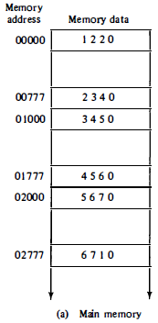
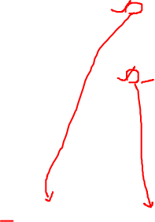
Set-associative mapping
It can accommodate 1024 words of main memory since each word of cache contains two data words
The words stored at addresses 01000 and 02000 of main memory are stored in cache memory at index address 000.
Similarly, the words at addresses 02777 and 00777 are stored in cache at index address 777.
When the CPU generates a memory request, the index value of the address is used to access the cache. The tag field of the CPU address is then compared with both tags in the cache to determine if a match occurs.
The comparison logic is done by an associative search of the tags in the set similar to an associative memory search: thus the name "set-associative."
The hit ratio will improve as the set size increases because more words with the same index but different tags can reside in cache.
Notes:
It consists of a memory
array and logic for m words with n bits per word. The argument register A and key register K
each have n bits, one for each bit of a word. The match register M has m bits, one for each
memory word. Each word in memory is compared in parallel with the content of the
argument register. The words that match the bits of the argument register set a corresponding
bit in the match register. After the matching process, those bits in the match register that
have been set indicate the fact that their corresponding words have been matched. Reading is
accomplished by a sequential access to memory for those words whose corresponding bits in
the match register have been set.
The key register provides a mask for choosing a particular field or key in theargument word.
The entire argument is compared with each memory word if the key register contains all l's.
Thus the key provides a mask or identifying piece of information which specifies how the
reference to memory is made.

Slide 72
Replacement algorithms
Random replacement
firs -in, first-out (FIFO)
Least recently used (LRU)
Notes:
It consists of a memory
array and logic for m words with n bits per word. The argument register A and key register K
each have n bits, one for each bit of a word. The match register M has m bits, one for each
memory word. Each word in memory is compared in parallel with the content of the
argument register. The words that match the bits of the argument register set a corresponding
bit in the match register. After the matching process, those bits in the match register that
have been set indicate the fact that their corresponding words have been matched. Reading is
accomplished by a sequential access to memory for those words whose corresponding bits in
the match register have been set.
The key register provides a mask for choosing a particular field or key in theargument word.
The entire argument is compared with each memory word if the key register contains all l's.
Thus the key provides a mask or identifying piece of information which specifies how the
reference to memory is made.

Slide 73
Writing into Cache
Write through method:
The simplest and most commonly used procedure is to update main memory with every memory write operation, with cache memory being updated in parallel if it contains the word at the specified address. This is called the write-through method.
This method has the advantage that main memory always contains the same data as the cache.
This characteristic is important in systems with direct memory access transfers.
It ensures that the data residing in main memory are valid at all times so that an I/O device communicating through DMA would receive the most recent updated data.
Notes:
It consists of a memory
array and logic for m words with n bits per word. The argument register A and key register K
each have n bits, one for each bit of a word. The match register M has m bits, one for each
memory word. Each word in memory is compared in parallel with the content of the
argument register. The words that match the bits of the argument register set a corresponding
bit in the match register. After the matching process, those bits in the match register that
have been set indicate the fact that their corresponding words have been matched. Reading is
accomplished by a sequential access to memory for those words whose corresponding bits in
the match register have been set.
The key register provides a mask for choosing a particular field or key in theargument word.
The entire argument is compared with each memory word if the key register contains all l's.
Thus the key provides a mask or identifying piece of information which specifies how the
reference to memory is made.

Slide 74
Writing into Cache
Write back method:
In this method only the cache location is updated during a write operation. The location is then marked by a flag so that later when the word is removed from the cache it is copied into main memory.
The reason for the write-back method is that during the time a word resides in the cache, it may be updated several times; however, as long as the word remains in the cache, it does not matter whether the copy in main memory is out of date, since requests from the word are filled from the cache.
It is only when the word is displaced from the cache that an accurate copy need be rewritten into main memory.
Notes:
It consists of a memory
array and logic for m words with n bits per word. The argument register A and key register K
each have n bits, one for each bit of a word. The match register M has m bits, one for each
memory word. Each word in memory is compared in parallel with the content of the
argument register. The words that match the bits of the argument register set a corresponding
bit in the match register. After the matching process, those bits in the match register that
have been set indicate the fact that their corresponding words have been matched. Reading is
accomplished by a sequential access to memory for those words whose corresponding bits in
the match register have been set.
The key register provides a mask for choosing a particular field or key in theargument word.
The entire argument is compared with each memory word if the key register contains all l's.
Thus the key provides a mask or identifying piece of information which specifies how the
reference to memory is made.

Slide 75
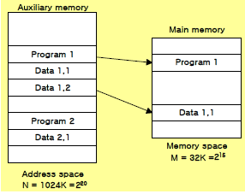

Virtual memory
Virtual Memory: Auxiliary memory → Main memory
Translate program-generated (Aux. Memory) address into main memory location
Give programmers the illusion that they have a very large memory, even though the computer actually has a relatively small main memory
Address Space & Memory Space
Address Space : Virtual Address»Address used by a programmer
memory Space : Physical Address(Location)»Address in main memory
address space (N) = 1024 K = 2^20 → Auxiliary Memory
memory space (M) = 32 K = 2^15 → main Memory
Notes:
It consists of a memory
array and logic for m words with n bits per word. The argument register A and key register K
each have n bits, one for each bit of a word. The match register M has m bits, one for each
memory word. Each word in memory is compared in parallel with the content of the
argument register. The words that match the bits of the argument register set a corresponding
bit in the match register. After the matching process, those bits in the match register that
have been set indicate the fact that their corresponding words have been matched. Reading is
accomplished by a sequential access to memory for those words whose corresponding bits in
the match register have been set.
The key register provides a mask for choosing a particular field or key in theargument word.
The entire argument is compared with each memory word if the key register contains all l's.
Thus the key provides a mask or identifying piece of information which specifies how the
reference to memory is made.

Slide 76
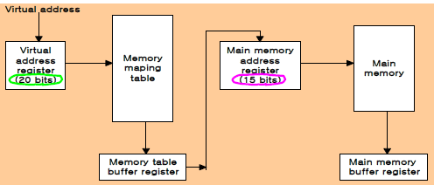
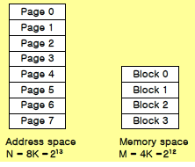

Virtual memory
Memory table for mapping a virtual address → Translate the20 bits Virtual addressinto the 15 bits Physical address
Consider computer with an address space of 8K and a memory space of 4K.
Notes:
It consists of a memory
array and logic for m words with n bits per word. The argument register A and key register K
each have n bits, one for each bit of a word. The match register M has m bits, one for each
memory word. Each word in memory is compared in parallel with the content of the
argument register. The words that match the bits of the argument register set a corresponding
bit in the match register. After the matching process, those bits in the match register that
have been set indicate the fact that their corresponding words have been matched. Reading is
accomplished by a sequential access to memory for those words whose corresponding bits in
the match register have been set.
The key register provides a mask for choosing a particular field or key in theargument word.
The entire argument is compared with each memory word if the key register contains all l's.
Thus the key provides a mask or identifying piece of information which specifies how the
reference to memory is made.

Slide 77
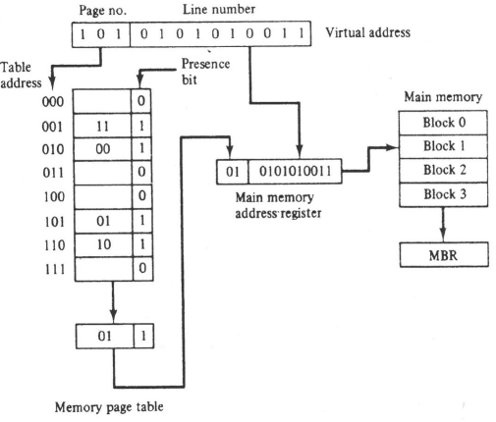
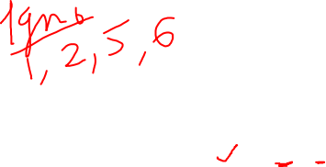
Virtual memory
Memory table for mapping a virtual address → Translate the20 bits Virtual addressinto the 15 bits Physical address
Notes:
It consists of a memory
array and logic for m words with n bits per word. The argument register A and key register K
each have n bits, one for each bit of a word. The match register M has m bits, one for each
memory word. Each word in memory is compared in parallel with the content of the
argument register. The words that match the bits of the argument register set a corresponding
bit in the match register. After the matching process, those bits in the match register that
have been set indicate the fact that their corresponding words have been matched. Reading is
accomplished by a sequential access to memory for those words whose corresponding bits in
the match register have been set.
The key register provides a mask for choosing a particular field or key in theargument word.
The entire argument is compared with each memory word if the key register contains all l's.
Thus the key provides a mask or identifying piece of information which specifies how the
reference to memory is made.

Slide 78
Virtual memory
A random-access memory page table is inefficient with respect to storage utilization.
we observe that eight words of memory are needed, one for each page, but at least four words will always be marked empty because main memory cannot accommodate more than four blocks.
In general, a system with n pages and m blocks would require a memory-page table of n locations of which up to m blocks will be marked with block numbers and all others will be empty.
consider an address space of 1024K words and memory space of 32K words. If each page or block contains 1K words, the number of pages is 1024 and the number of blocks 32.
The capacity of the memory-page table must be 1024 words and only 32 locations may have a presence bit equal to 1. At any given time, at least 992 locations will be empty and not in use.
Notes:
It consists of a memory
array and logic for m words with n bits per word. The argument register A and key register K
each have n bits, one for each bit of a word. The match register M has m bits, one for each
memory word. Each word in memory is compared in parallel with the content of the
argument register. The words that match the bits of the argument register set a corresponding
bit in the match register. After the matching process, those bits in the match register that
have been set indicate the fact that their corresponding words have been matched. Reading is
accomplished by a sequential access to memory for those words whose corresponding bits in
the match register have been set.
The key register provides a mask for choosing a particular field or key in theargument word.
The entire argument is compared with each memory word if the key register contains all l's.
Thus the key provides a mask or identifying piece of information which specifies how the
reference to memory is made.

Slide 79
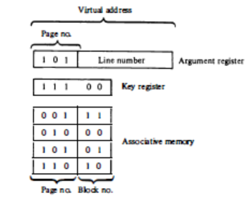
Virtual memory
A more efficient way to organize the page table would be to construct it with a number of words equal to the number of blocks in main memory. In this way the size of the memory is reduced and each location is fully utilized.
This method can be implemented by means of an associative memory with each word in memory containing a page number together with its corresponding block number. The page field in each word is compared with the page number in the virtual address. If a match occurs, the word is read from memory and its corresponding block number is extracted
Notes:
It consists of a memory
array and logic for m words with n bits per word. The argument register A and key register K
each have n bits, one for each bit of a word. The match register M has m bits, one for each
memory word. Each word in memory is compared in parallel with the content of the
argument register. The words that match the bits of the argument register set a corresponding
bit in the match register. After the matching process, those bits in the match register that
have been set indicate the fact that their corresponding words have been matched. Reading is
accomplished by a sequential access to memory for those words whose corresponding bits in
the match register have been set.
The key register provides a mask for choosing a particular field or key in theargument word.
The entire argument is compared with each memory word if the key register contains all l's.
Thus the key provides a mask or identifying piece of information which specifies how the
reference to memory is made.

Slide 80
PAGE REPLACEMENT ALGORITHMS
Random Replacement Algorithm
FIFO Replacement Algorithm
Least Replacement Algorithm

Slide 81
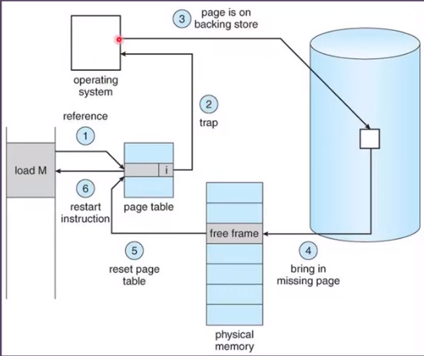
PAGE fault
Notes:
It consists of a memory
array and logic for m words with n bits per word. The argument register A and key register K
each have n bits, one for each bit of a word. The match register M has m bits, one for each
memory word. Each word in memory is compared in parallel with the content of the
argument register. The words that match the bits of the argument register set a corresponding
bit in the match register. After the matching process, those bits in the match register that
have been set indicate the fact that their corresponding words have been matched. Reading is
accomplished by a sequential access to memory for those words whose corresponding bits in
the match register have been set.
The key register provides a mask for choosing a particular field or key in theargument word.
The entire argument is compared with each memory word if the key register contains all l's.
Thus the key provides a mask or identifying piece of information which specifies how the
reference to memory is made.

Slide 82

Memory Management Hardware
A memory management system is a collection of hardware and software procedures for managing the various programs residing in memory.
The memory management software is part of an overall operating system available in many computers. Here we are concerned with the hardware unit associated with the memory management system.

Slide 83
Memory Management Hardware
The dynamic storage relocation hardware is a mapping process similar to the paging system.
The fixed page size used in the virtual memory system causes certain difficulties with respect to program size and the logical structure of programs.
It is more convenient to divide programs and data into logical parts called segments.
A segment is a set of logically related instructions or data elements associated with a given name. Segments may be generated by the programmer or by the operating system.
Examples of segments are a subroutine, an array of data, a table of symbols, or a user's program.

Slide 84
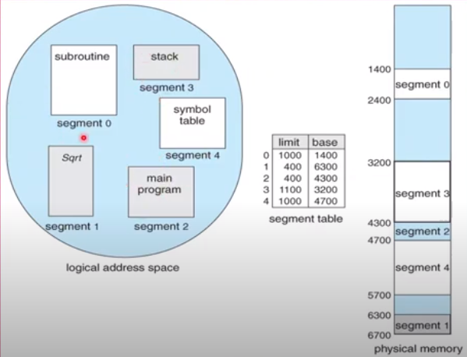
Memory Management Hardware

Slide 85
Memory Management Hardware
The sharing of common programs is an integral part of a multiprogramming system. Eg. Compiler.
Other system programs residing in memory are also shared by all users in a multiprogramming system without having to produce multiple copies.
The other issue in multiprogramming is protecting one program from unwanted interaction with another. An example of unwanted interaction is one user's unauthorized copying of another user's program.
Another aspect of protection is concerned with preventing the occasional user from performing operating system functions and thereby interrupting the orderly sequence of operations in a computer installation.

Slide 86
Memory Management Hardware
Logical Address
The address generated by a segmented program similar to virtual address
Virtual Address : fixed-length page
Logical Address : variable-length segment
The logical address may be larger than the physical memory address as in virtual memory, but it may also be equal, and sometimes even smaller than the length of the physical memory address.
Shared programs are placed in a unique segment in each user's logical address space so that a single physical copy can be shared.
In addition to relocation information, each segment has protection information associated with it.

Slide 87
Memory Management Hardware
Segmented-Page Mapping
The property of logical space is that it uses variable-length segments. The length of each segment is allowed to grow and contract according to the needs of the program being executed.
One way of specifying the length of a segment is by associating with it a number of equal-size pages.
The logical address is partitioned into three fields.
The segment field specifies a segment number.
The page field specifies the page within the segment
The word field gives the specific word within the page.
A page field of k bits can specify up to 2^{K} pages. A segment number may be associated with just one page or with as many as 2^{K} pages. Thus the length of a segment would vary according to the number of pages that are assigned to it.

Slide 88
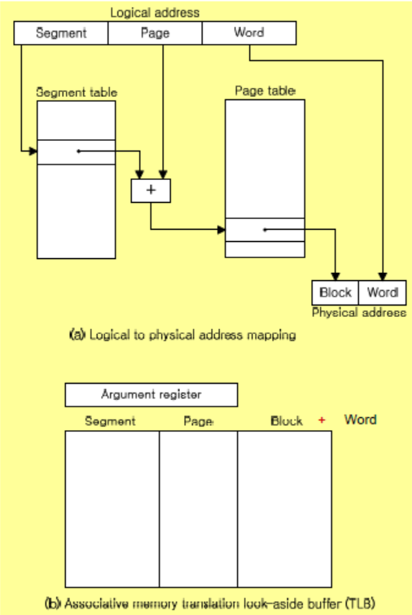
Memory Management Hardware
The mapping of the logical address into a physical address is done by means of two tables, as shown in Fig(a).
The segment number of the logical address specifies the address for the segment table.
The entry in the segment table is a pointer address for a page table base.
The page table base is added to the page number given in the logical address.

Slide 89
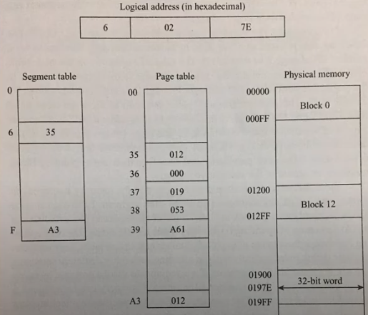
Memory Management Hardware

Slide 90
Memory Management Hardware
The sum produces a pointer address to an entry in the page table. The value found in the page table provides the block number in physical memory.
The concatenation of the block field with the word field produces the final physical mapped address.
The two mapping tables may be stored in two separate small memories or in main memory. In either case, a memory reference from the CPU will require three accesses to memory: one from the segment table, one from the page table, and the third from main memory.
This would slow the system significantly when compared to a conventional system that requires only one reference to memory.
To avoid this speed penalty, a fast associative memory is used to hold the most recently referenced table entries. (This type of memory is sometimes called a translation lookaside buffer, abbreviated TLB. )

Slide 91
Memory Management Hardware
The first time a given block is referenced, its value together with the corresponding segment and page numbers are entered into the associative memory as shown in Fig(b).
Thus the mapping process is first attempted by associative search with the given segment and page numbers.
If it succeeds, the mapping delay is only that of the associative memory.
If no match occurs, the slower table mapping of Fig. (a) is used and the result transformed into the associative memory for future reference.

Slide 92
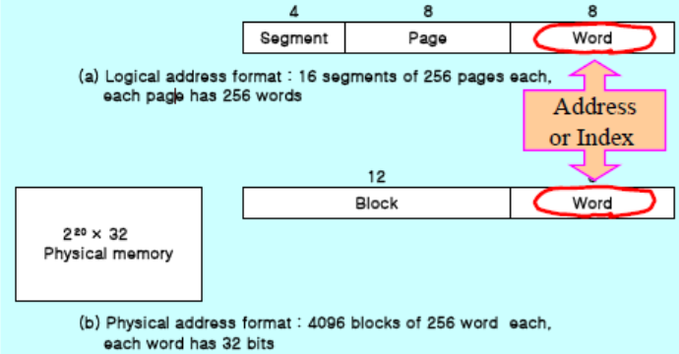
Memory Management Hardware
Numerical Example
Logical address & Physical address
» Logical Address :
4 bit segment : 16 segments
8 bit page : 256 pages
8 bit word : 256 address field
» Physical Address :
12 bit block : 4096 blocks
8 bit word : 256 address field

Slide 93
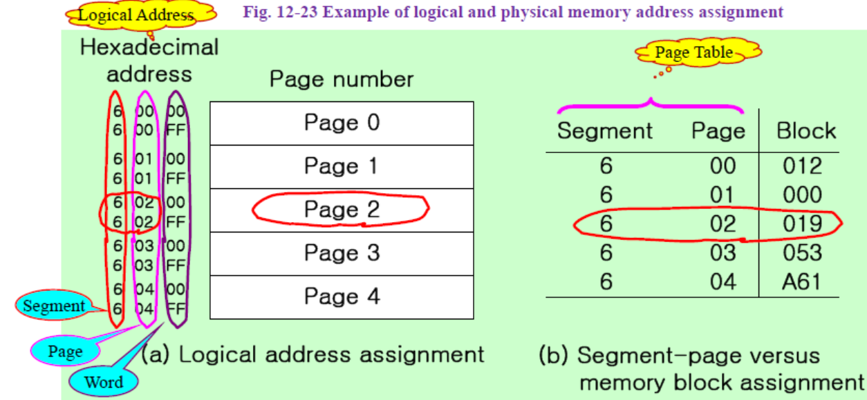
Memory Management Hardware

Slide 94
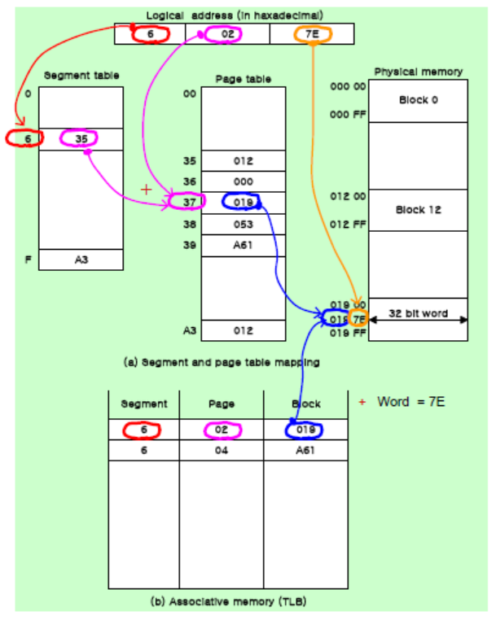
Memory Management Hardware

Slide 95
Memory Management Hardware
Memory Protection
Memory protection can be assigned to the physical address or the logical address.
The protection of memory through the physical address can be done by assigning to each block in memory a number of protection bits that indicate the type of access allowed to its corresponding block.
Every time a page is moved from one block to another it would be necessary to update the block protection bits.
A much better place to apply protection is in the logical address space rather than the physical address space.
This can be done by including protection information within the segment table or segment register of the memory management hardware.
The content of each entry in the segment table or a segment register is called a descriptor.
A typical descriptor would contain, in addition to a base address field, one or two additional fields for protection purposes.
The base address field gives the base of the page table address in a segmented-page organization or the block base address in a segment register organization.
The length field gives the segment size by specifying the maximum number of pages assigned to the segment.

Slide 96
Memory Management Hardware
Memory Protection
The protection field in a segment descriptor specifies the access rights available to the particular segment.
In a segmented-page organization, each entry in the page table may have its own protection field to describe the access rights of each page.
The protection information is set into the descriptor by the master control program of the operating system.
Some of the access rights of interest that are used for protecting the programs residing in memory are:
1. Full read and write privileges
2. Read only (write protection)
3. Execute only (program protection)
4. System only (operating system protection)

Slide 97
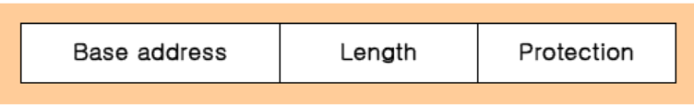
Memory Management Hardware
Memory Protection
Typical segment descriptor
Intel segment descriptor format : DPL(Descriptor Privilege Level)
Access Rights : protecting the programs residing in memory
1) Full read and write privileges : no protection
2) Read only : write protection
3) Execute only : program protection
4) System only : operating system protection

Slide 98
THANK YOU

